Slide 1
The Volatility Trap: Redundancy as a Phase Transition in Human Capital
Michael W. Green
Simplify Asset Management
Ergodicity Economics Conference 2026

Slide 2
Introduction
Standard economic models often treat inequality as a result of differential skill ($\mu$) or effort. We propose that inequality is a phase transition driven by Systemic Redundancy ($R$) relative to Environmental Volatility ($\sigma_{env}$).
Models that fail to incorporate this insights will lead to markedly lower aggregate and median growth, camouflaged by averages, and contributing to social stress
Unfortunate similarities to financial markets suggest impending high volatility outcomes

Slide 3
The Core Thesis: Reliability over Efficiency
Reliability vs. Optimization: Complex adaptive systems maximize fitness by optimizing reliability, which can only be built from unreliable components through redundancy.
Efficiency Pruning: The US economy has systematically removed redundancy (buffers) from the bottom 40% of the labor force.
The Non-Ergodicity Trap: This structurally forces this sub-population into a non-ergodic regime where capital accumulation is mathematically impossible

Slide 4
We model human capital accumulation ($W_t$) as a Geometric Brownian Motion (GBM) with potential drift ($\mu$), volatility ($\sigma_{env}$), and a Restart Barrier.
$$dW_t = \mu W_t dt + \sigma W_t dB_t$$The Restart Mechanism: Real-world ruin events are distinct state-destruction events. If wealth hits a barrier ($W_t \le W_{barrier}$), the state resets to a lower fraction: $W_t \rightarrow \delta \cdot W_{barrier}$, where $0 < \delta < 1$.The Time-Average Growth: $g_{time} \approx \eta + \lambda(R, \sigma) \cdot \ln(\delta)$. Growth is the ergodic growth rate ($\eta$) minus the restart drag (intensity $\lambda$ times the log-penalty $\ln(\delta)$).

Slide 5
Empirical Evidence: The "Natural Experiment"To prove that volatility ($\sigma$), not skill ($\mu$), drives divergence, we analyze the Academic Calendar.School Year (Buffered): High redundancy, low volatility. Low-SES and High-SES students experience learning growth at statistically similar rates.Summer Break (Unbuffered): Low redundancy, high volatility. High-SES students continue to grow due to private buffers, while Low-SES students experience stagnation or regression.Conclusion: The "Achievement Gap" is an accumulation of unhedged variance during unbuffered intervals

Slide 6
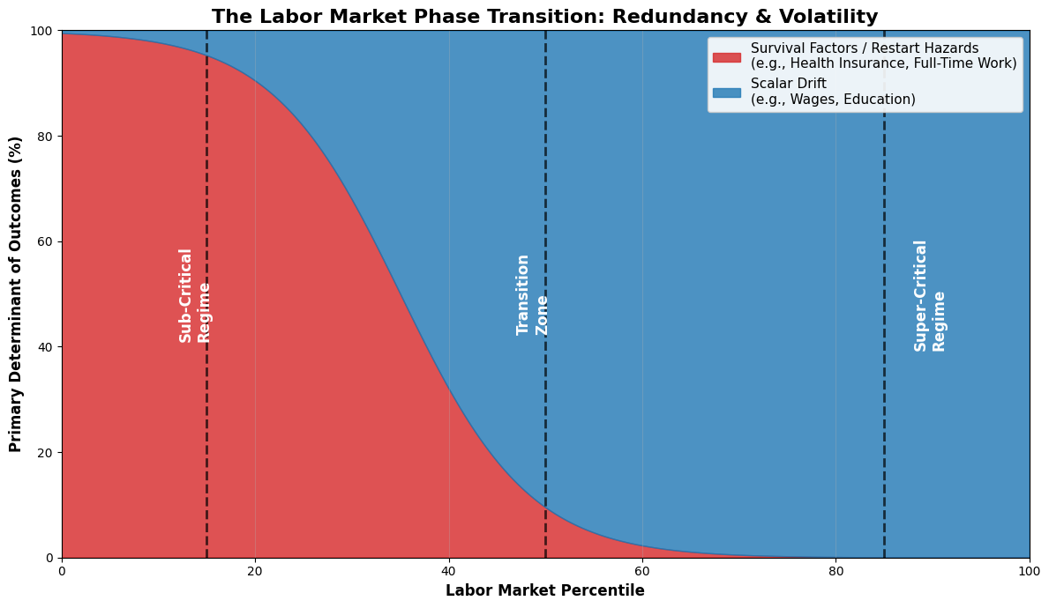
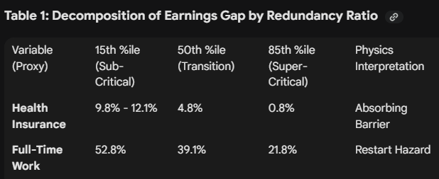
Labor Market Phase Transitions
Applying this framework to the US labor market reveals a sharp divergence at the Redundancy Ratio threshold.
  Sub-Critical Regime (Bottom 15%): Outcomes are mechanistically determined by "Restart Hazards" (e.g., lack of health insurance, lack of full-time work).
  Super-Critical Regime (Above 50%): Survival factors evaporate, and outcomes are determined by Scalar Drift, such as wages and education.

Slide 7
Historical Context & Policy ImplicationsThe 19th-Century "Restart Experiment": The explosion of private capital was driven by legal engineering that raised the recovery value ($\delta$).Limited Liability (1855): Raised $\delta$ from near-zero to near-unity for investors.Bankruptcy Reform: Standardized reorganization turned failure into a "liquidity event".The Policy Imperative: Transitioning from poverty to wealth requires "Latent Heat" (Redundancy). Portable Benefits and Baby Bonds are Phase Stabilizers that keep the bottom 40% in a compounding regime.

Slide 8
Simulation Architecture (The Python Model)We simulate $10,000$ agents over a $T=40$ time horizon using GBM.Parameters: Potential drift $\mu=0.05$ and volatility $\sigma=0.20$.The Costly Restart: If wealth hits the ruin barrier ($W_{barrier} = 1000$), agents suffer a 50% haircut ($\delta = 0.5$), systematically destroying capital rather than just pausing growth.

Slide 9
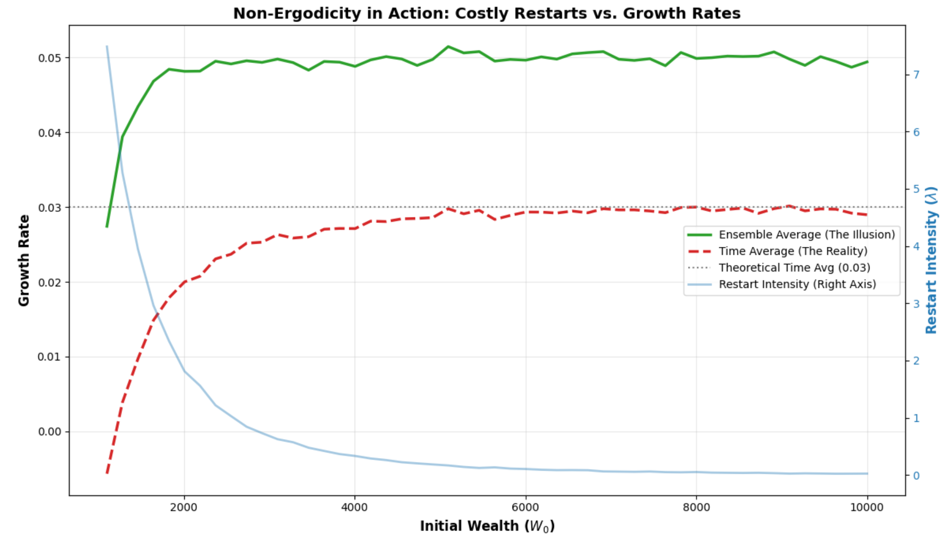
The impact – reduced aggregate growth due to constrained actors

Slide 10
The Measurement Divergence & Phase TransitionEnsemble Average ($g_{ens}$): The arithmetic mean of wealth. It is heavily dominated by survivors, creating an "illusion" of systemic growth.Time Average ($g_{time}$): The geometric mean (mean of the logs). It captures the severe penalty of ruin events, reflecting the mathematical "reality".The Phase Transition: Below a critical redundancy threshold, the drag from the Restart Intensity ($\lambda$) overwhelms the drift, driving realized growth ($g_{time}$) negative regardless of potential productivity.

Slide 11
Macro Translation: Systemic Fragility in Financial Markets
The Income Replacement Trap
  We've built a retirement system that encourages the accumulation of assets to protect against a future loss of income. This results in systemic asset hoarding and macroeconomic fragility as incomes for workers are reduced.
The "Efficiency Pruning" of Passive Flow
  Modern ETF and passive structures optimize for tracking efficiency by actively dispensing with the cash buffer that facilitates redemptions without selling, removing a key shock absorber and raising system fragility.
Simulating the Sub-Critical Market
  When similar restart dynamics are simulated in equity and credit markets, the absence of buffers changes the topology of the market, creating instantaneous crashes against apparently minor disruptions.

Slide 12
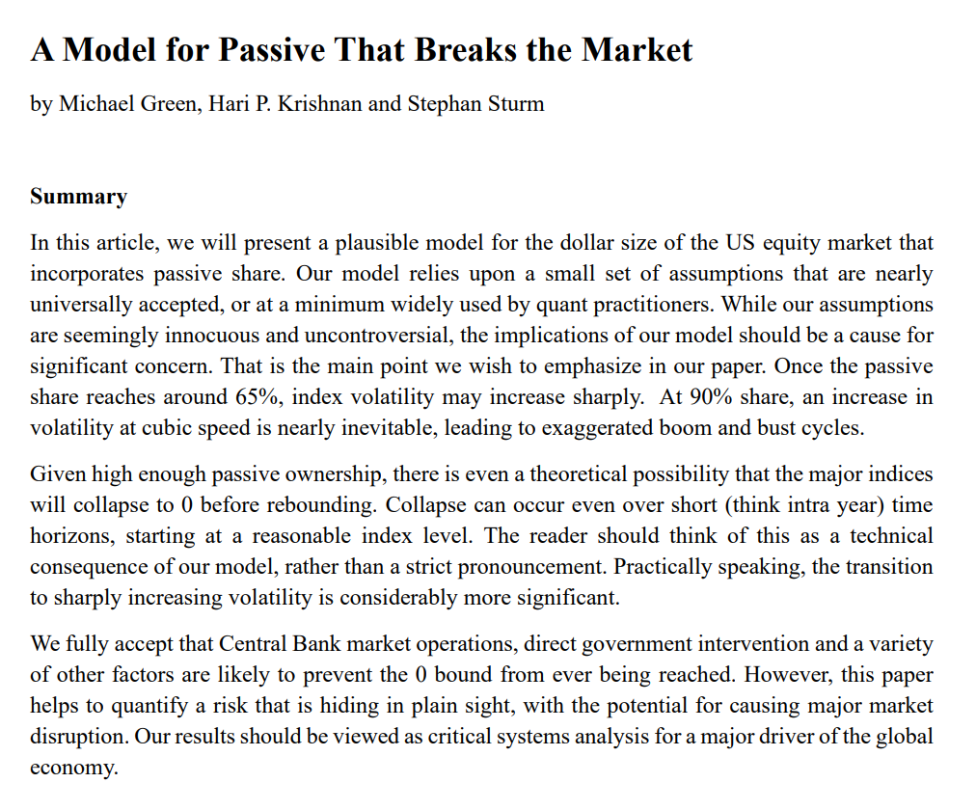
Pending paper

